Slide 1
EDA and Machine Learning on Spam/Ham messages Prediction
INSAID

Slide 2
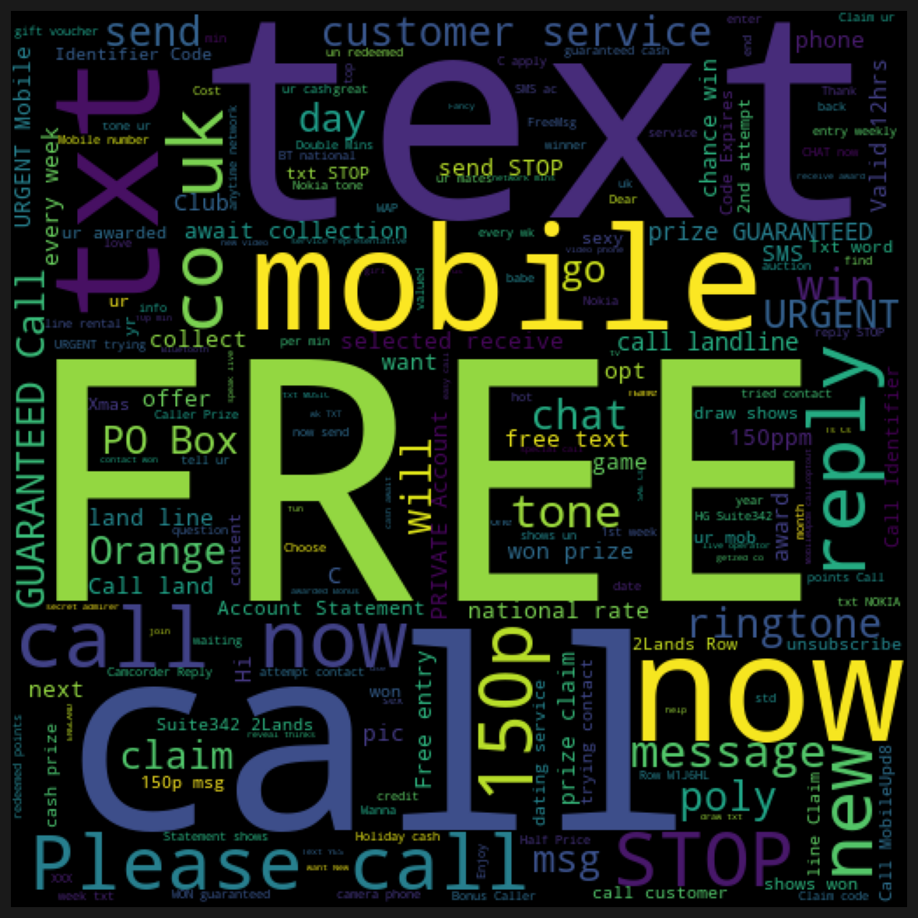
Problem Statement
To analyze and predict the Spam/Ham messages data based on set of SMS tagged messages that have been collected for SMS Spam research.

Slide 3
About the Dataset
Overview :
This dataset is a set of SMS tagged messages that have been collected for SMS Spam research.
It contains one set of SMS messages in English of 5,574 messages, tagged according being ham
(legitimate) or spam.
v1- column with two categories spam and ham. To tell the messages if they are spam or ham
category.
v2- column contains the messages list
Remaining three are unnamed columns with no necessary values later will drop them.

Slide 4
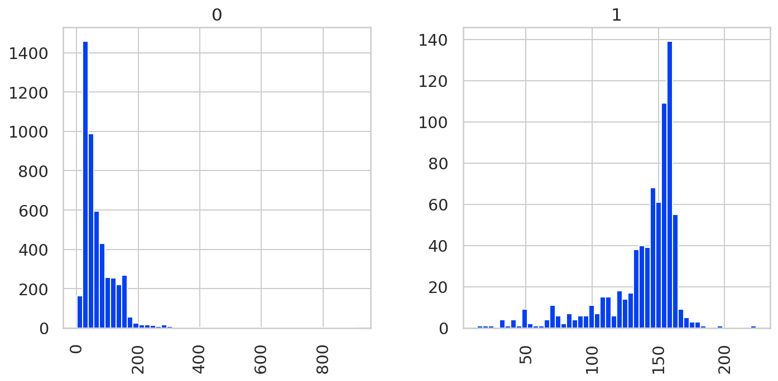
Analyze the length of messages for spam and ham using seaborn.
From the above plot we can see that lengthy is the message, more likely it is a spam.

Slide 5
Model Development:
 | Score
KNN | 0.91210
NB | 0.98340
LR | 0.97847
RF | 0.97130
From the above models we generated we can say that we got the better accuracy for Naive Bayes analysis as compared to other models.

Slide 6
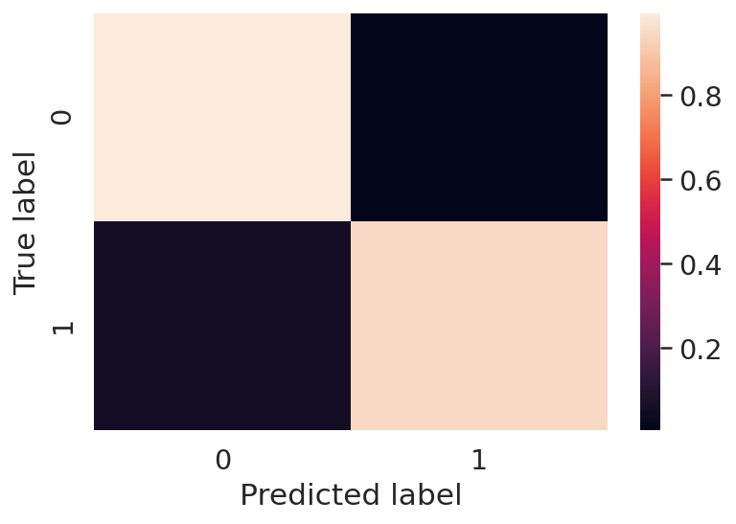
Model Evaluation: Confusion Matrix
precision recall f1-score support
Ham 0.99 0.99 0.99 965
Spam 0.97 0.95 0.96 150
accuracy 0.99 1115
macro avg 0.98 0.97 0.97 1115
weighted avg 0.99 0.99 0.99 1115
[[960 5]
[ 8 142]]
By seeing the above confusion matrix, it is clear that 5 Ham are mis-classified as Spam, and 8 Spam are misclassified as Ham.

Slide 7
Conclusion
We performed EDA to understand the relationship between both columns.
We have seen how the length of text is differentiated between spam and ham.
We constructed different machine learning models like Naive Bayes, KNN, linear regression model, decision tree model, random forest model and got best result with Naive Bayes model.
We performed advanced feature engineering to know the spam classified as ham and ham classified as spam.
We created word cloud to see the texts commonly used.

